Slide 1
General Goals of Evaluation Design: Accuracy, Coverage, Confidence and Trust, Novelty, Serendipity, Diversity, Scalability, Segmenting the Ratings for Training and Testing,
Accuracy Metrics in Offline Evaluation.

Slide 2
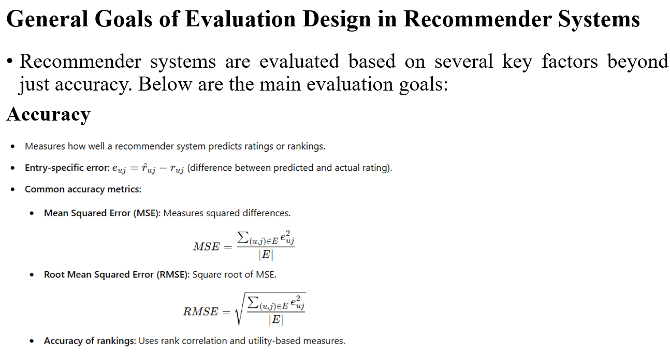

Slide 3
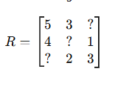
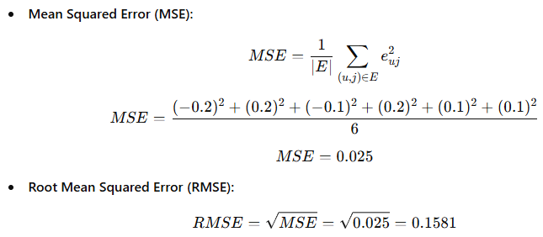
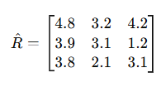
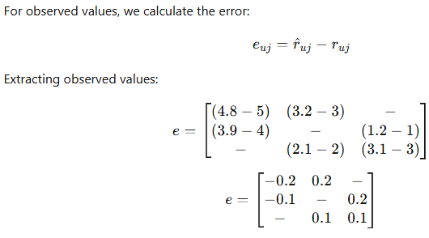
Note: Lower MSE and RMSE indicate better prediction accuracy.

Slide 4
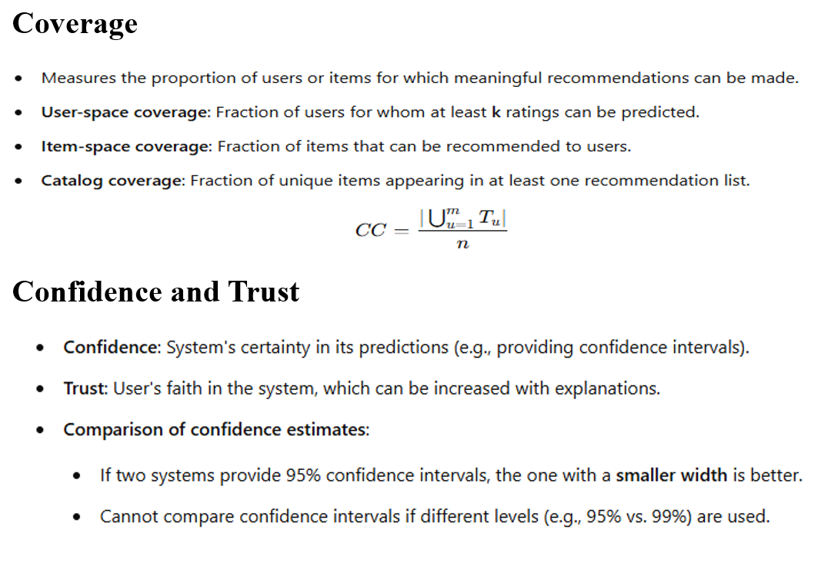

Slide 5
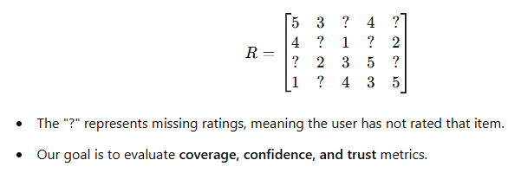
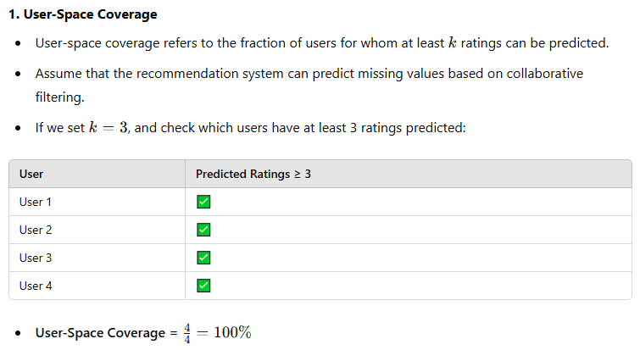

Slide 6
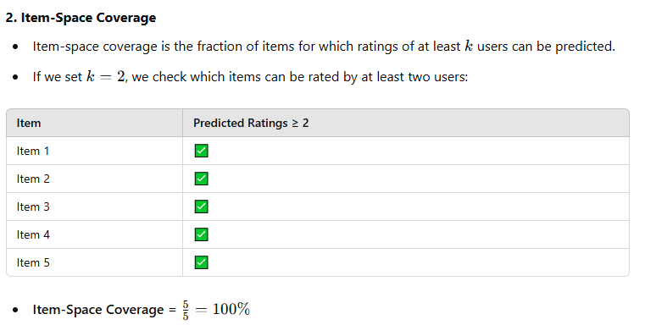
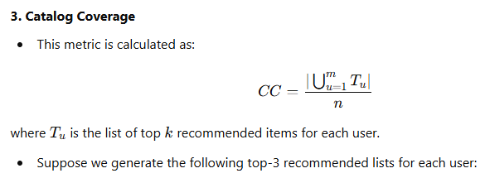

Slide 7
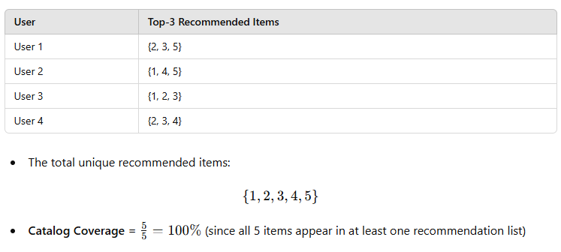
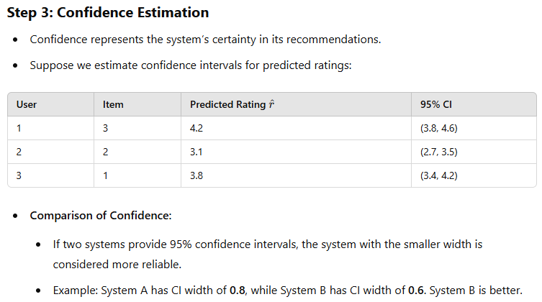

Slide 8
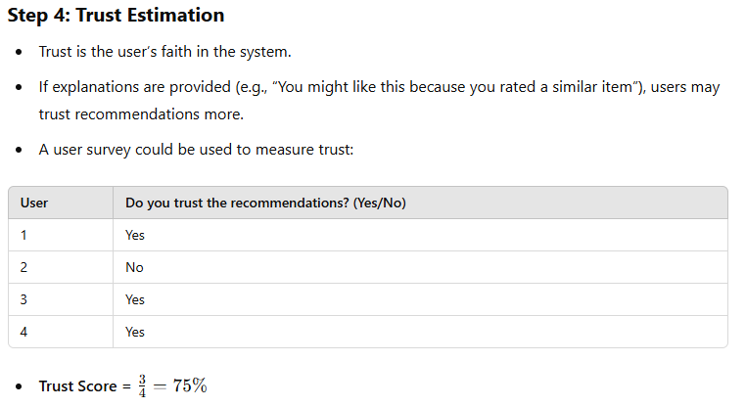

Slide 9
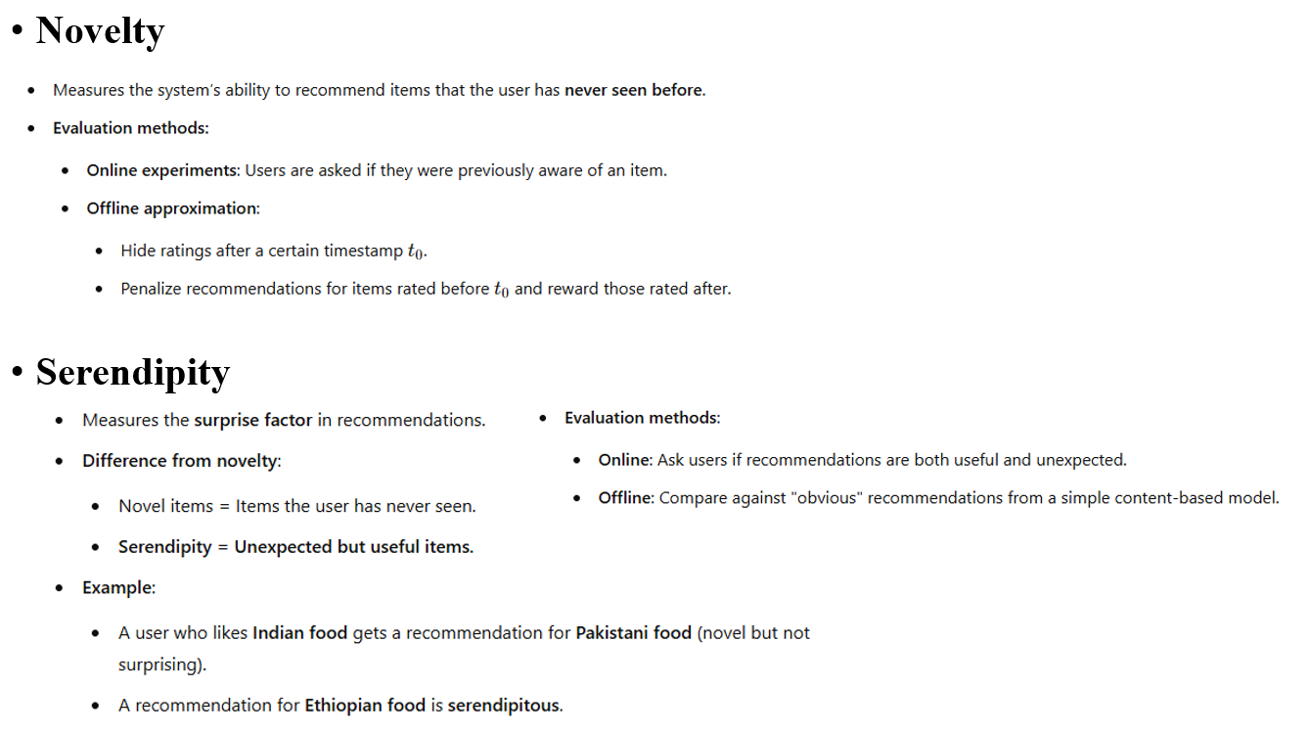

Slide 10
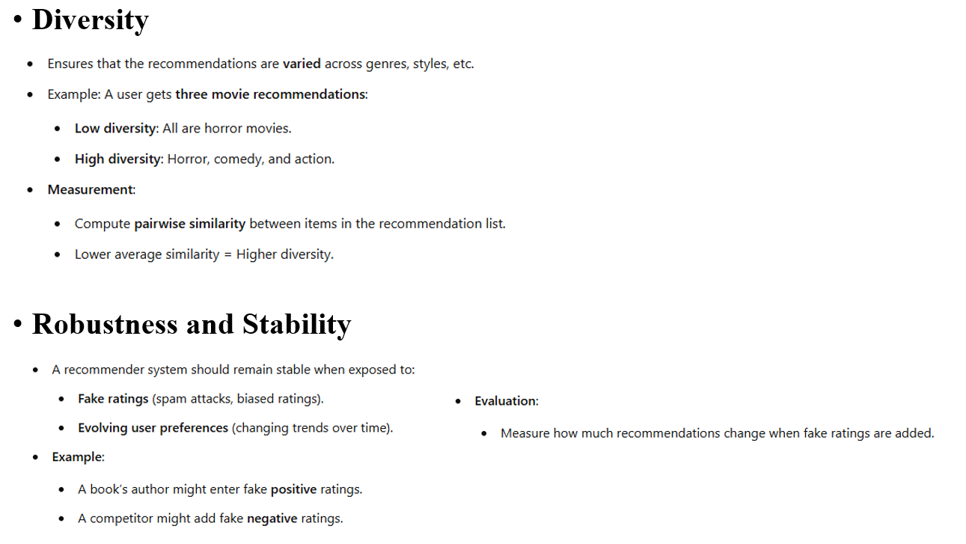

Slide 11
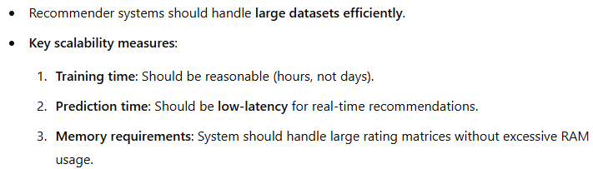
Scalability

Slide 12
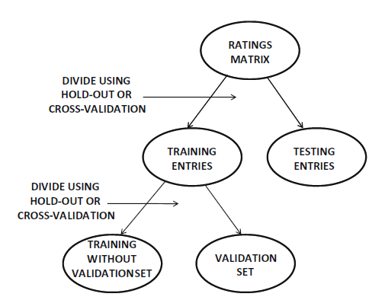
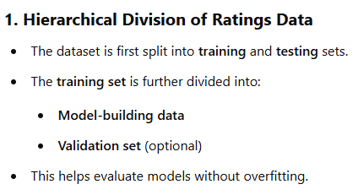
Segmenting the Ratings for Training and Testing in Recommender Systems
Recommender systems require training, validation, and test datasets for evaluation.
Since real-world datasets are not pre-partitioned, they must be split systematically.
The two most common methods are hold-out and cross-validation.

Slide 13
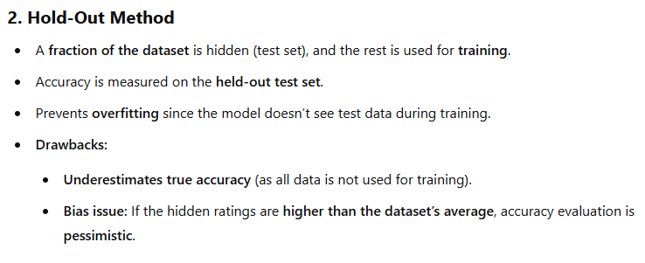
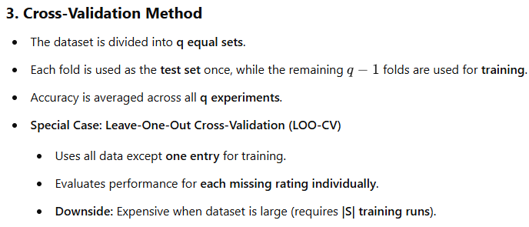

Slide 14
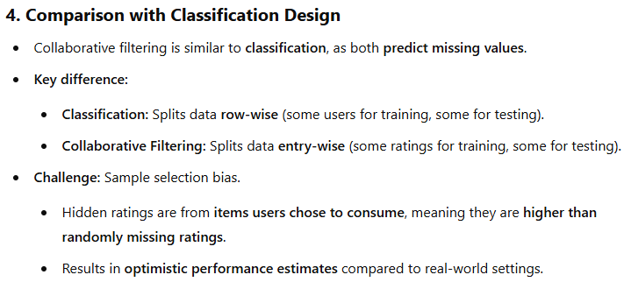

Slide 15
Accuracy Metrics in Offline Evaluation
Offline evaluation measures a recommendation system’s performance using historical data before real-world deployment.
It helps refine algorithms without exposing users to poor recommendations.
Two major categories of accuracy metrics:
Prediction accuracy metrics: Focus on how close predicted ratings are to actual ratings (e.g., RMSE, MAE).
Ranking accuracy metrics: Evaluate how well a model ranks relevant items for users.

Slide 16
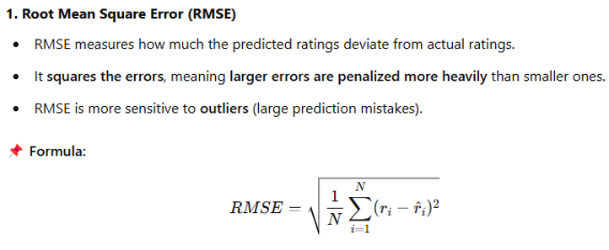
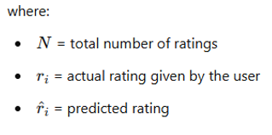
Measuring the Accuracy of Ratings Prediction
Many recommender systems predict numerical ratings (e.g., Netflix ratings from 1-5 stars).
The quality of these predictions is assessed using metrics like RMSE and MAE.
RMSE versus MAE

Slide 17
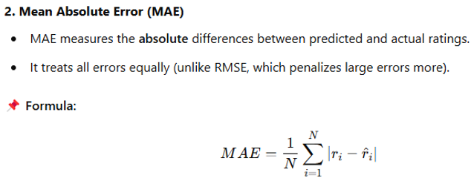

Slide 18
Impact of the Long Tail
What is the Long Tail?
In recommender systems, a few popular items (head) get most of the engagement, while many less popular items (long tail) have very few interactions.
Example: On Netflix, a few blockbuster movies dominate while thousands of niche movies are rarely watched.
Why is the Long Tail Important?
Most recommender systems favour popular items, which can lead to a lack of diversity.
Users might never discover rare but relevant items.
✅ Evaluation Approach:
Instead of just RMSE/MAE, use diversity and novelty metrics to ensure long-tail items are recommended.

Slide 19
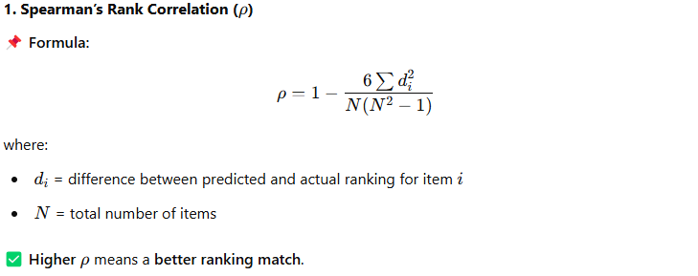
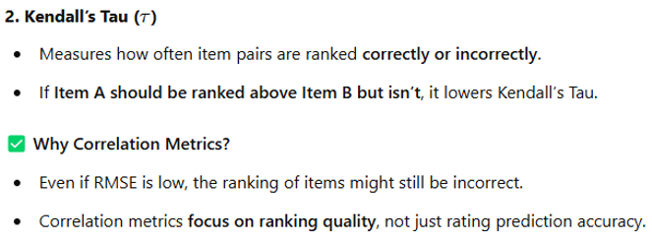
Evaluating Ranking via Correlation
Instead of just predicting ratings, recommendation systems should rank items in the correct order.
Ranking correlation measures how similar the predicted ranking is to the actual user preferences.

Slide 20
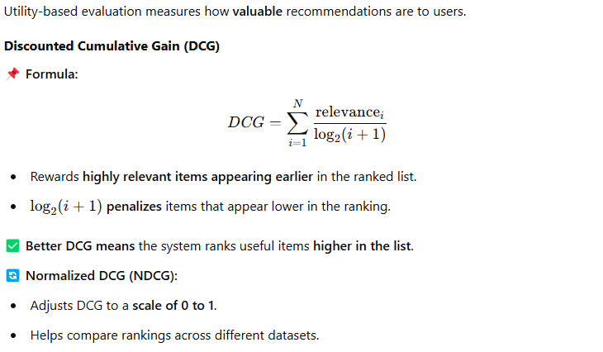
Evaluating Ranking via Utility

Slide 21
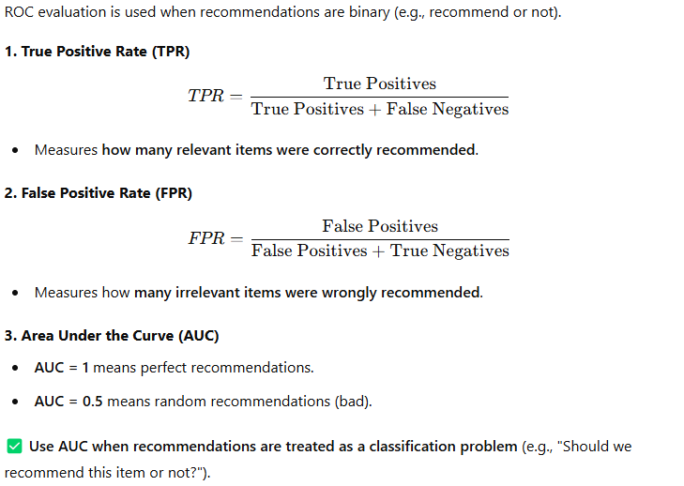
Evaluating Ranking via Receiver Operating Characteristic (ROC)

Slide 22
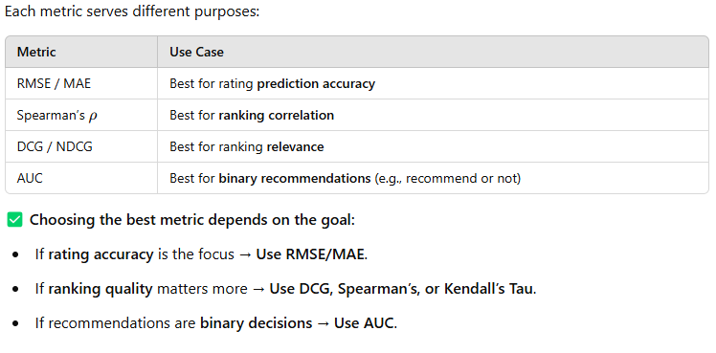
Which Ranking Measure is Best?

Slide 23
Conclusion
Offline evaluation is crucial in fine-tuning recommender systems before real deployment. No single metric is perfect—choosing the right one depends on the objective of the recommendation system.

